Slide 1
CAPSTONE PROJECT :
WEB AND SOCIAL MEDIA ANALYTICS
PRESENTED BY:
RAJESHWARI B C
OM SHIRKE
PUSHPARANI
Notes:
Objective

Slide 2
AGENDA
Objective
Background
Key findings
Recommendations
Appendix:
Data sources
Data methodology
Notes:
Objective

Slide 3
OBJECTIVE
To provide major insights for a cell phone industry to help them develop a new product optimally.
To tweak the marketing strategies in order to add more value to the product and close the supply-demand gap.
Notes:
Objective

Slide 4
BACKGROUND
As the firm has just entered the mobile market three years ago, they want to understand their competitors and preference of their users, so that they can design their strategies accordingly.
Notes:
Objective

Slide 5
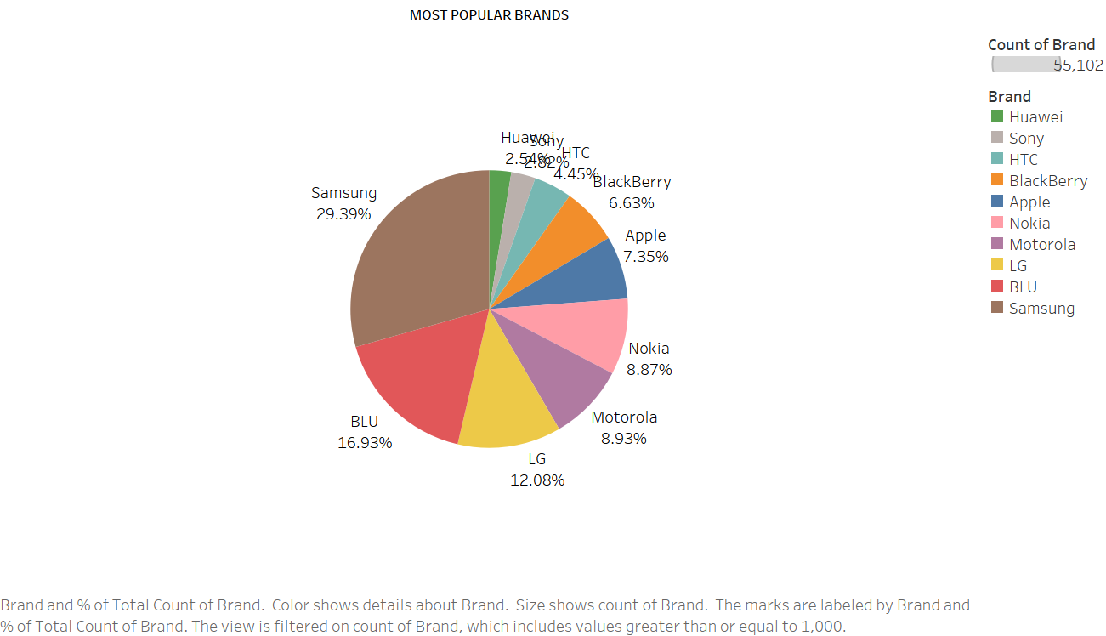
MARKET SHARE OF BRANDS
The most reviewed brands that have major popularity among users are Samsung(29.39%), Motorola(8.93%),LG(12.08%),Huawei(2.54%),HTC(4.09%), Blu(16.93%) and Apple(7.35%).
Since, now we know who the main market competitors are, we can devise our strategy and campaigns accordingly.

Slide 6
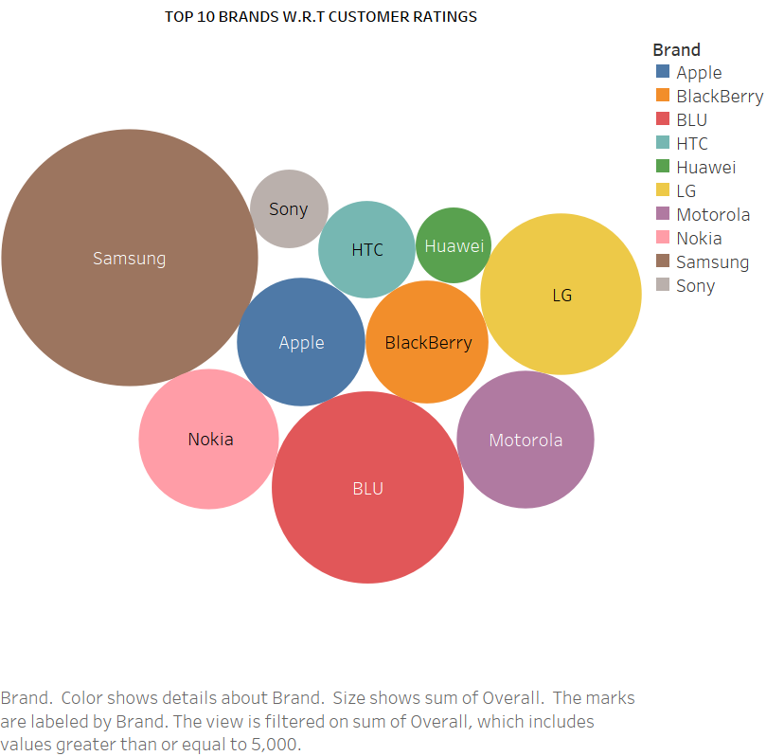
BRANDS WITH HIGHEST CUSTOMER RATINGS
By referring the various brands with respect to highest Customers Ratings, we observe that even though Samsung controls the major sector of the market in terms of popularity, other brands like LG, Apple, Blackberry, HTC, Huawei are also positively related.
These are the brands that are highest rated and highest trusted by the consumers.

Slide 7
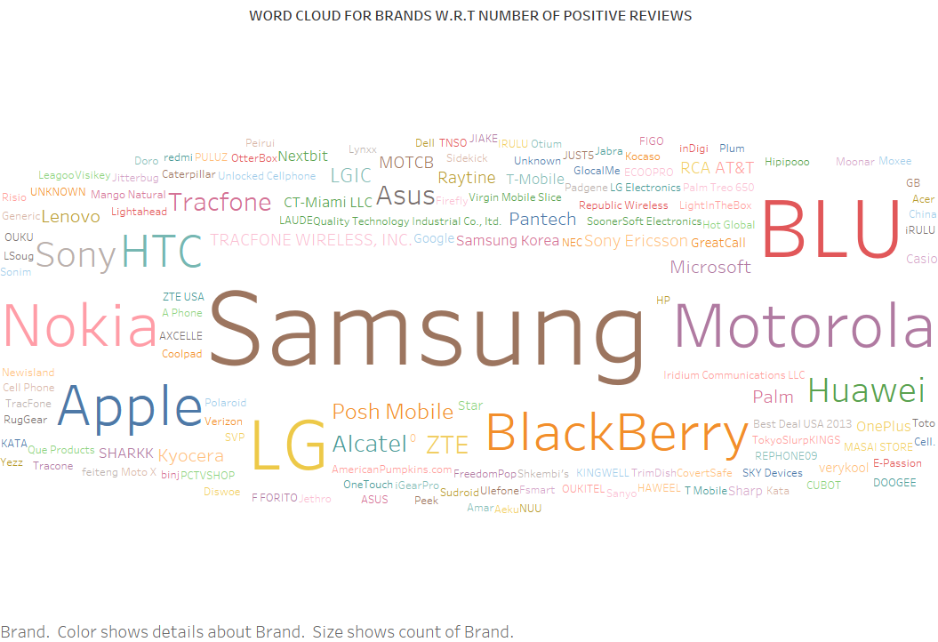
BRANDS WITH MAXIMUM POSITIVE REVIEWS
By referring to the word cloud for different brands w.r.t number of “positive reviews”, we can see that the most positively reviewed brands are Samsung, Blu, LG, Nokia, Apple and Motorola.
We see a similar pattern of same brands in all customer review and sentiment metrics.

Slide 8
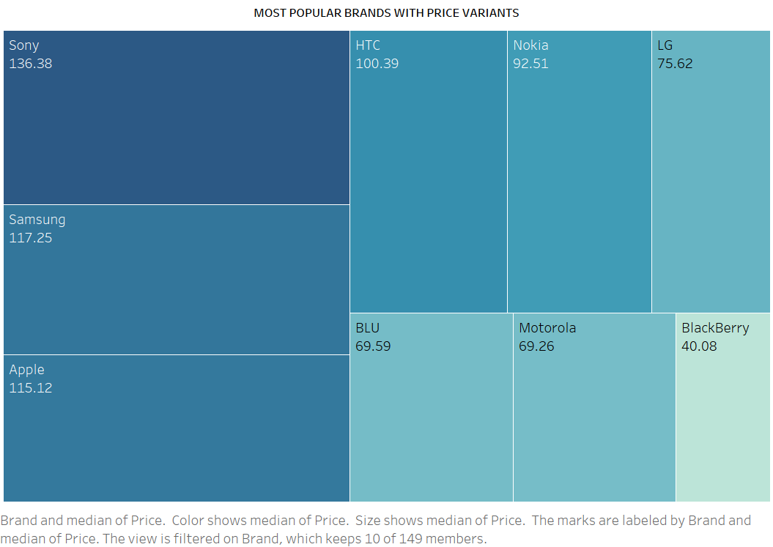
MOST POPULAR BRANDS WITH PRICE VARIANTS
The price of most popular brands preferred by the customers lies in the range of 136.36$ - 40.08$.
The above is the price range we need to target.
Let us now also study the features provided by these popular brands.

Slide 9
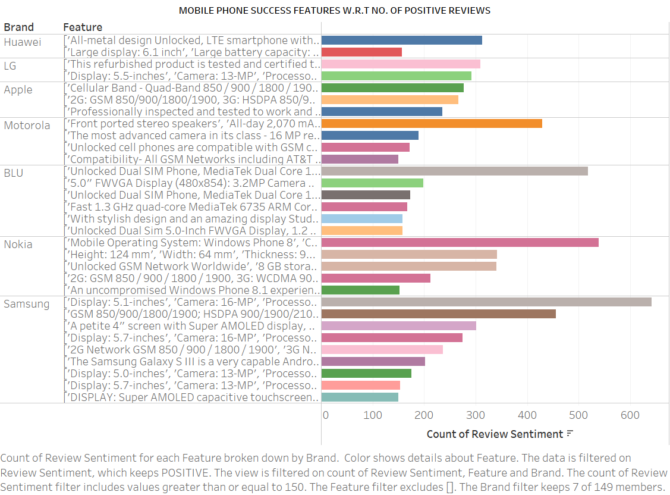
MOBILE PHONE ESSENTIAL FEATURES
One of the most desired feature includes a Display size of 5.1 inches, Camera with a 16MP rear lens and a processor having 2.5GHz cloaking speed.
Also, the all metal design LTE feature within Android, gives us an insight that the market we are focusing upon is majorly oriented to open-source platforms.

Slide 10
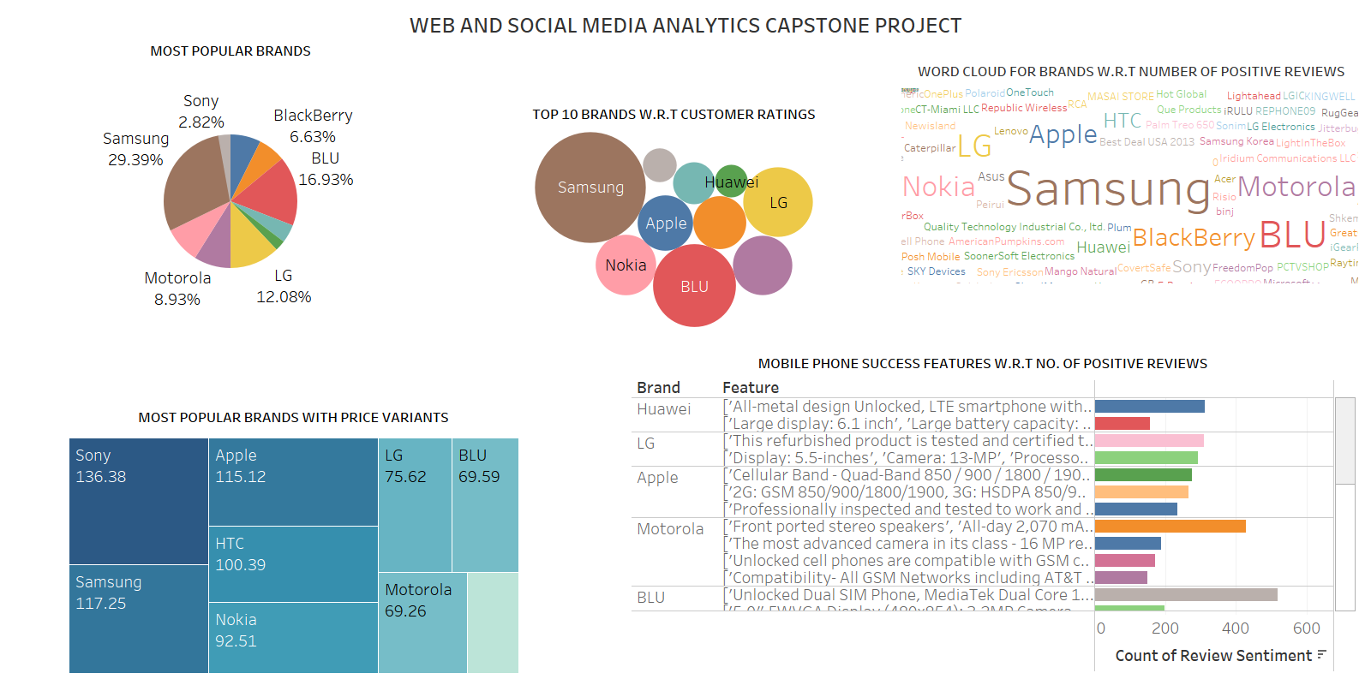
FINAL VISUALISATIONS DASHBOARD

Slide 11
RECOMMENDATIONS
Since, we discovered that, the most popular brands are Samsung, Motorola, HTC, Huawei and Apple; we MUST keep an eye on the services and features offered by them.
The market we must focus on is a mid range market segment, since, the most preferred price is in the range of 136$ - 40$. This gives us a sharp customer segment to penetrate and introduce our range of products in to maximize revenue.
The most in-demand features to consider are Android OS, 5.1-5.7 inches screen, a processor of 2.7 GHz and a camera of lens 16MP.
Notes:
Objective

Slide 12
APPENDIX
DATA SOURCE: Amazon review data (ucsd.edu)
METHODOLOGY:
STEP 1: Data cleaning and preprocessing.
STEP 2: Text Analytics with NLP to review the customer sentiment.
STEP 3: Tableau visualizations and Dashboard for better understanding.
STEP 4: Model Building and Evaluation using Naive Bayes ML algorithm.
Notes:
Objective

Slide 13
THANK YOU

Slide 14
VIDEO RECORDING EXPLATION ON THE BELOW LINK: https://drive.google.com/file/d/1bmrfD19-KqkHHu5-ZlChjNrFubd88td5/view?usp=sharing

